Slide 1
Gallup Polling Results

Slide 2
Wisconsin Polling
Total | Unweighted n | 503
 | Weighted n | 503
1 Republican |  | 151
 |  | 30%
2 Democrat |  | 137
 |  | 27%
3 Independent |  | 169
 |  | 34%
4 Something else |  | 45
 |  | 9%

Slide 3
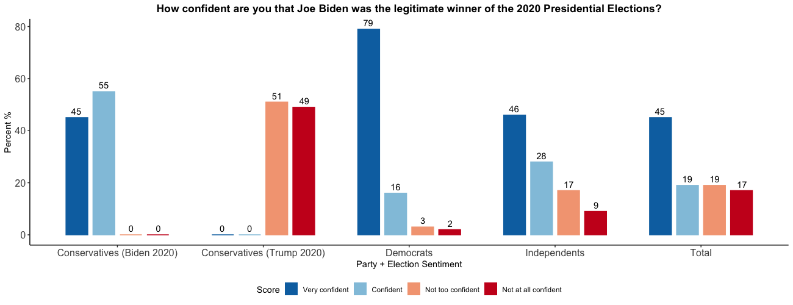
Wisconsin Polling

Slide 4
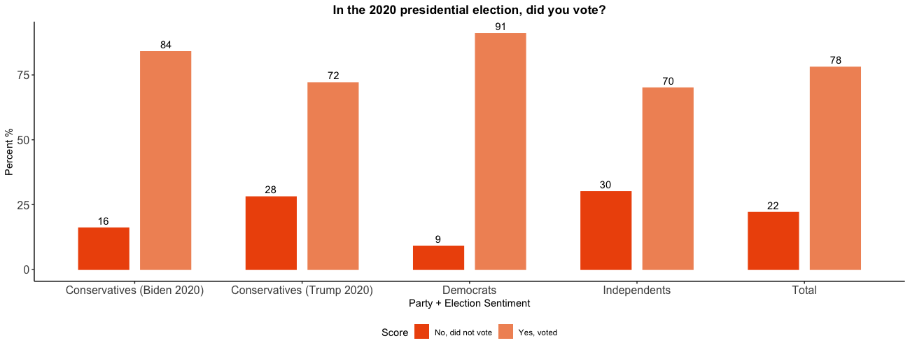
Wisconsin Polling

Slide 5
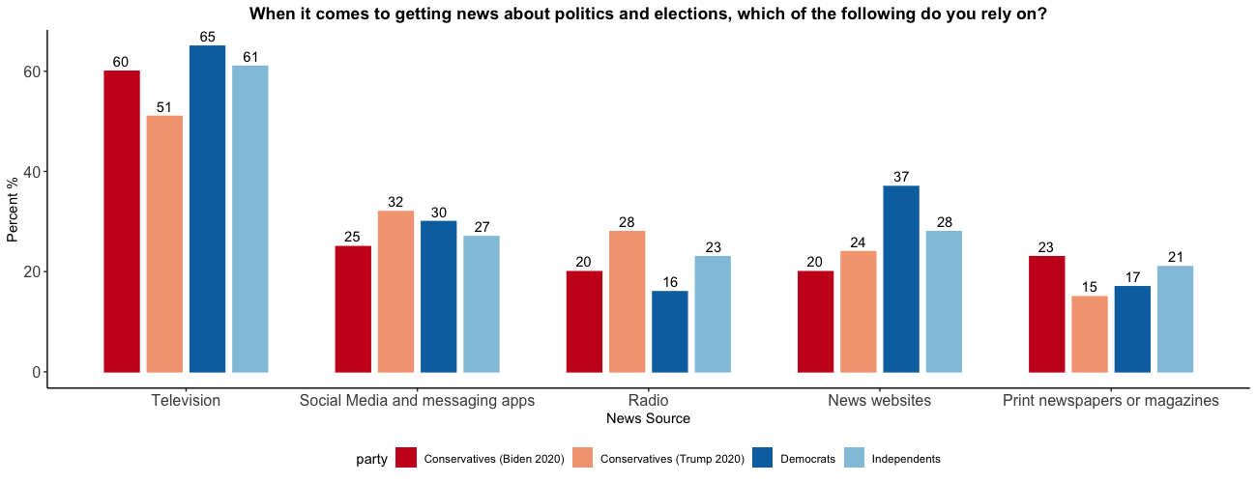
Wisconsin Polling

Slide 6
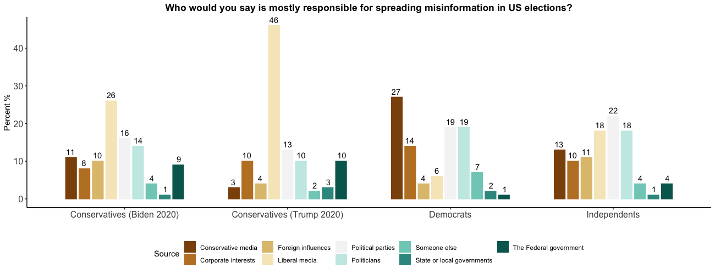
Wisconsin Polling

Slide 7
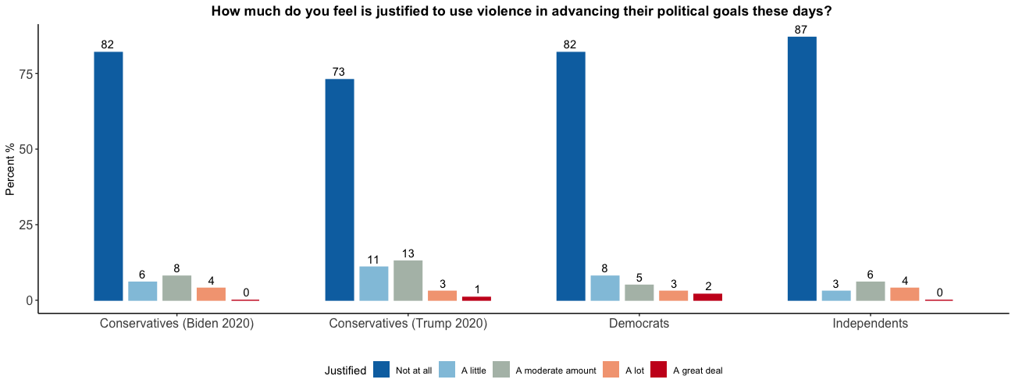
Wisconsin Polling

Slide 8
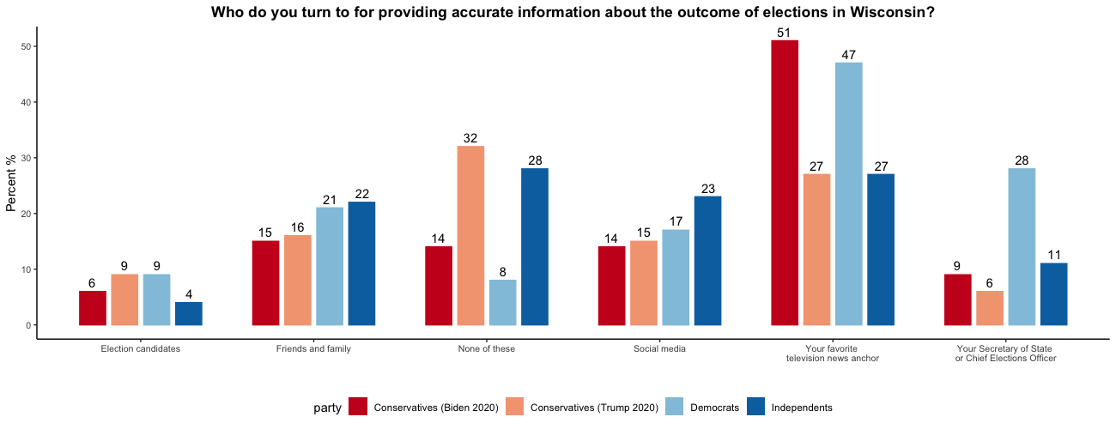
Wisconsin Polling

Slide 9
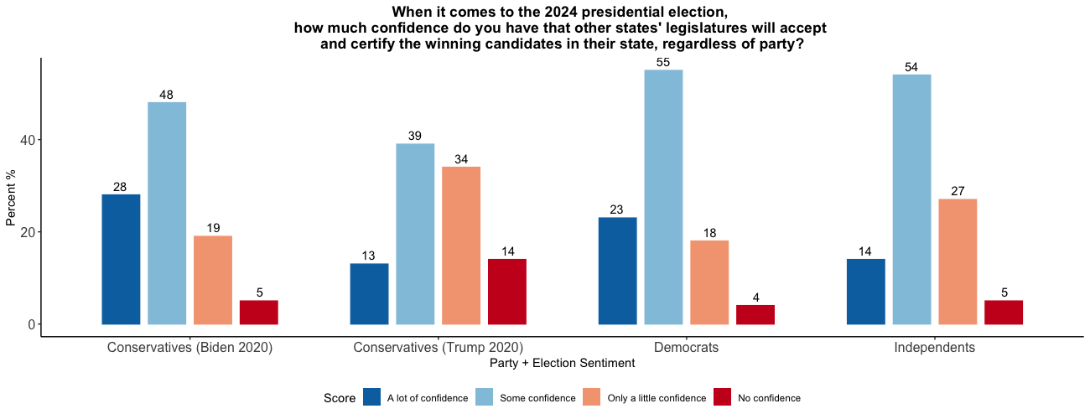
Wisconsin Polling

Slide 10
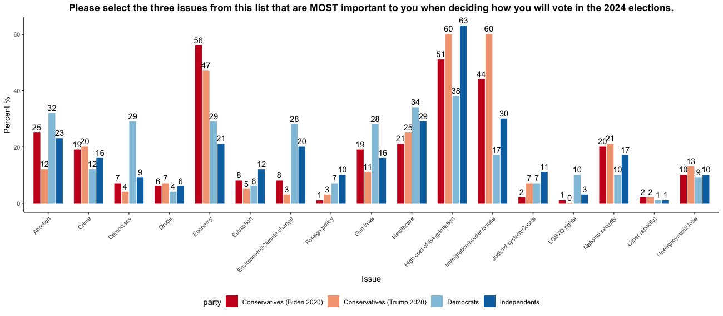
Wisconsin Polling

Slide 11
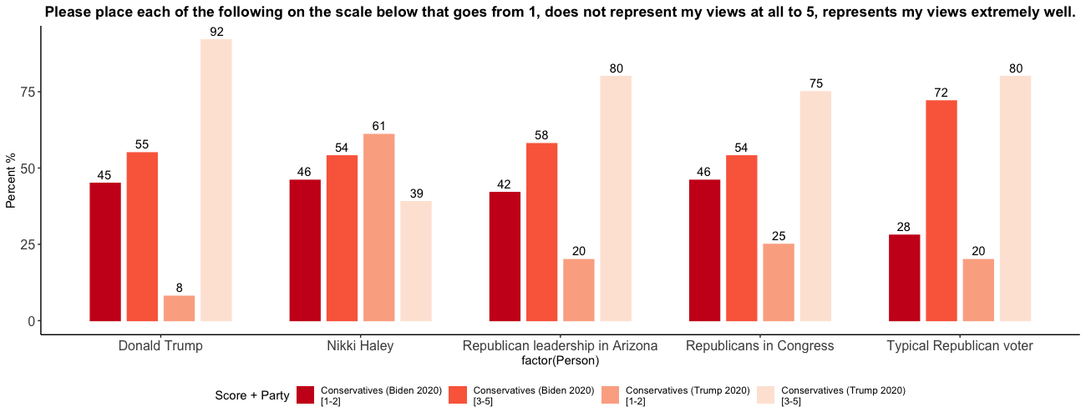
Wisconsin Polling

Slide 12
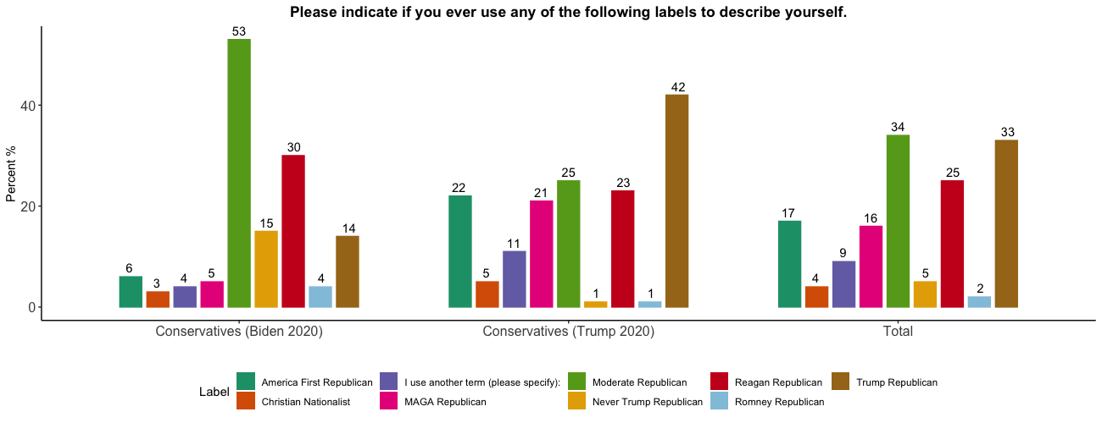
Wisconsin Polling

Slide 13
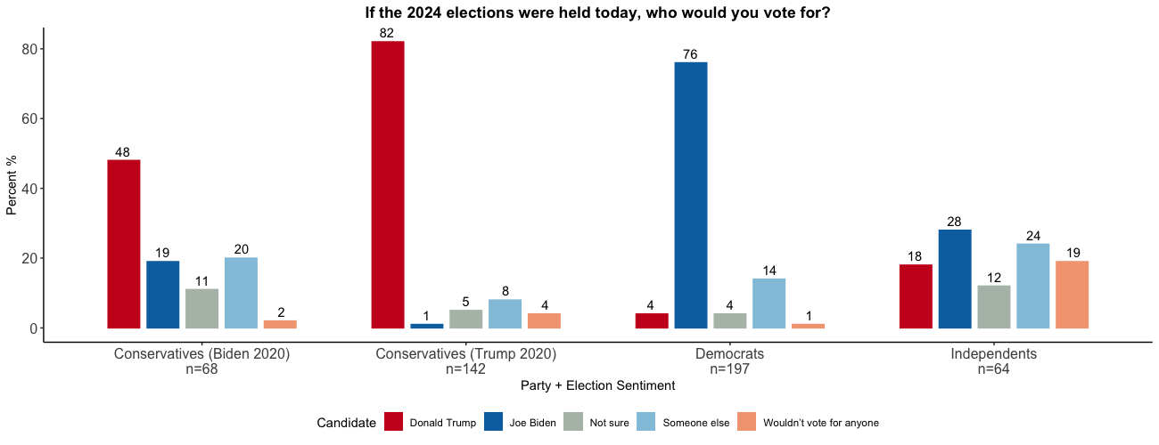
Wisconsin Polling

Slide 14
Arizona Polling
Total | Unweighted n | 503
 | Weighted n | 503
1 Republican |  | 151
 |  | 30%
2 Democrat |  | 137
 |  | 27%
3 Independent |  | 169
 |  | 34%
4 Something else |  | 45
 |  | 9%

Slide 15
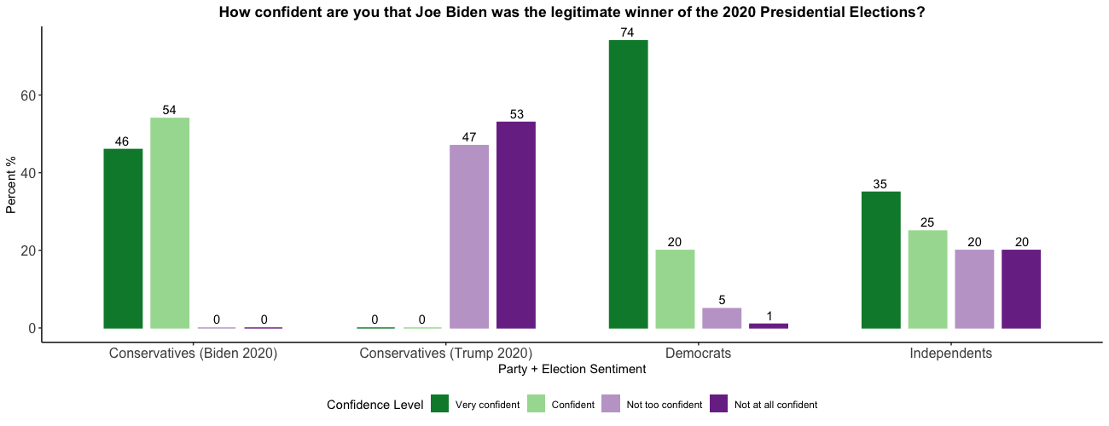
Arizona Polling

Slide 16
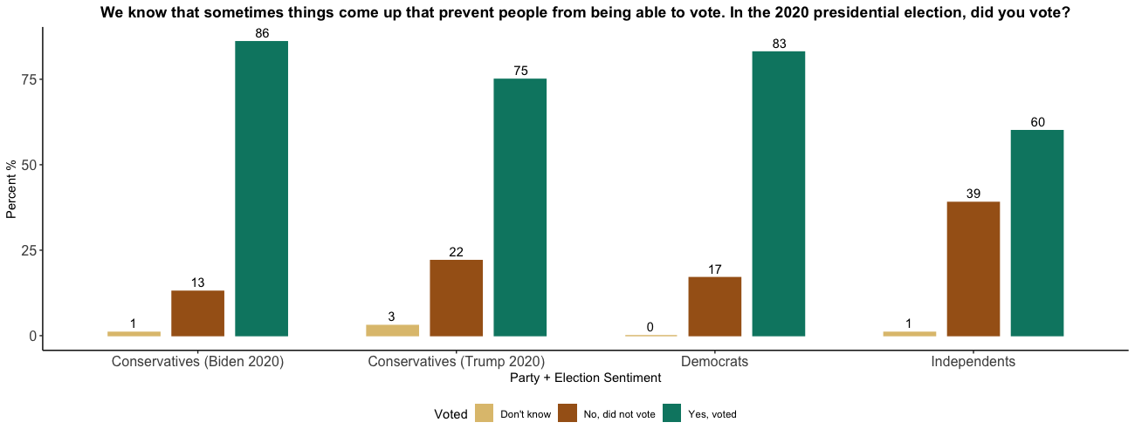
Arizona Polling

Slide 17
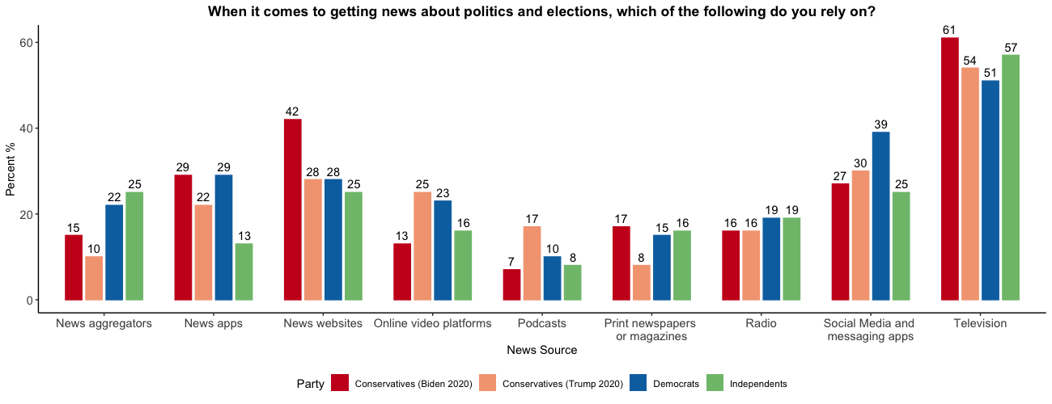
Arizona Polling

Slide 18
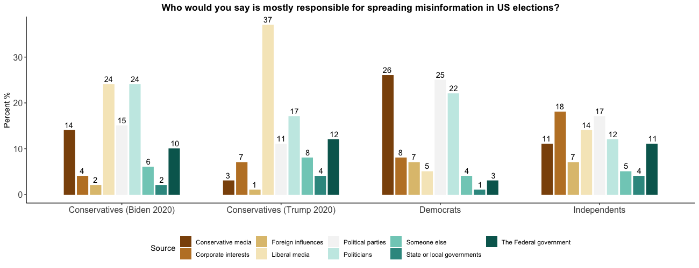
Arizona Polling

Slide 19
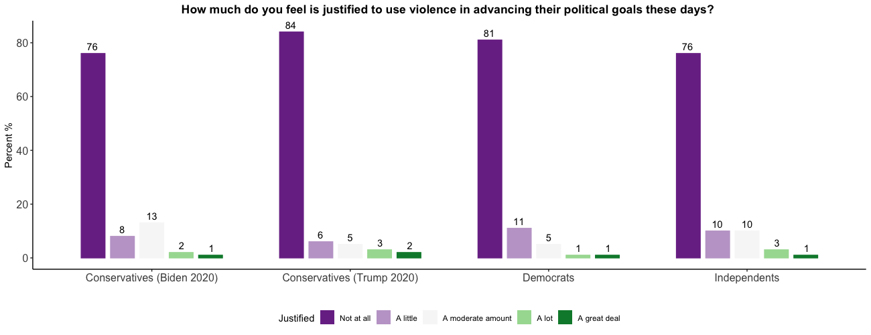
Arizona Polling

Slide 20
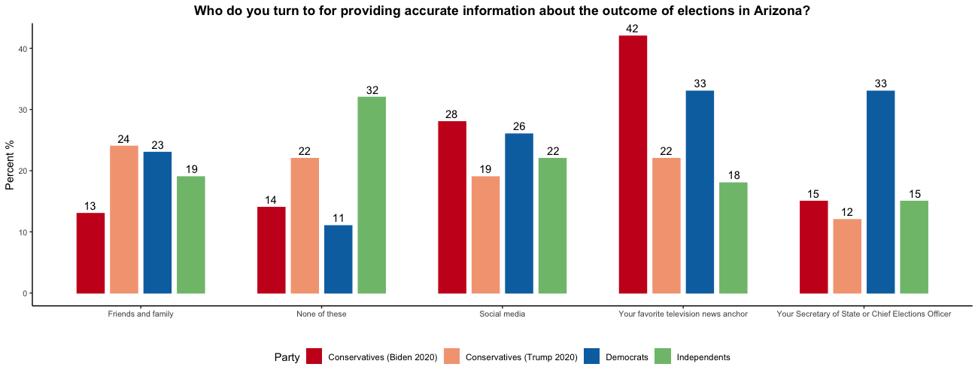
Arizona Polling

Slide 21
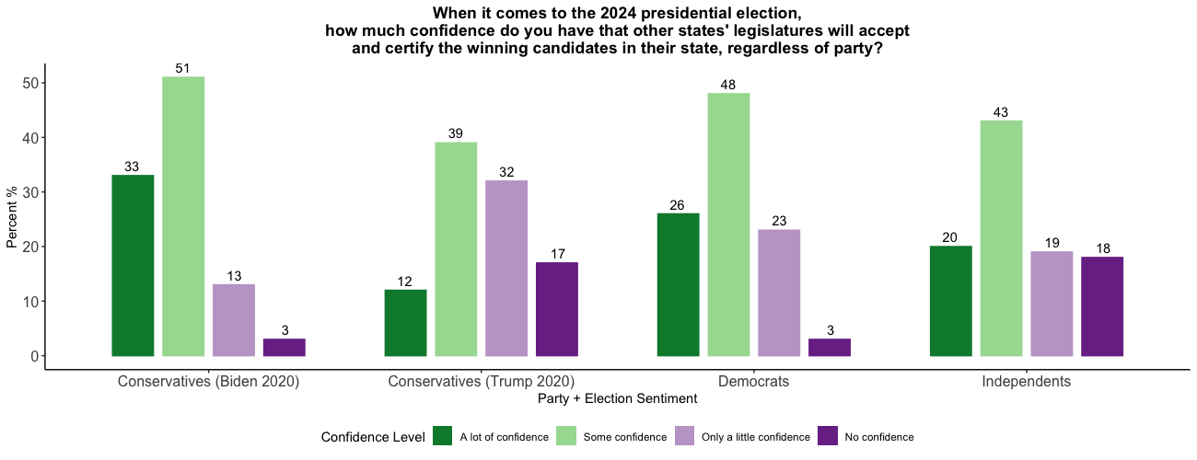
Arizona Polling

Slide 22
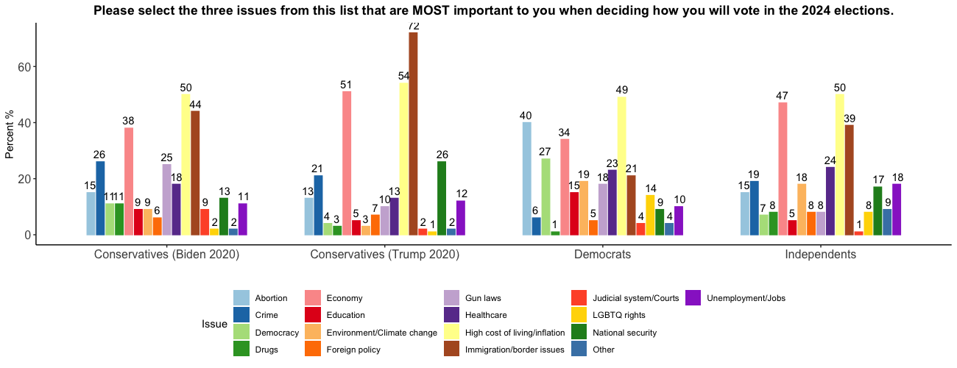
Arizona Polling

Slide 23
Arizona Polling

Slide 24
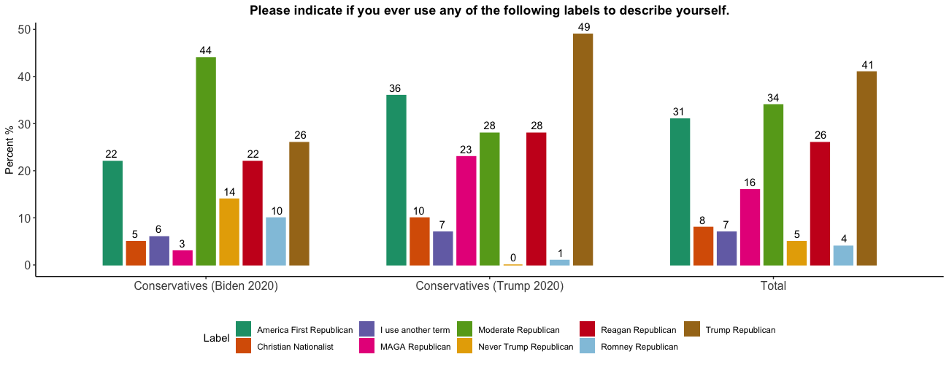
Arizona Polling

Slide 25
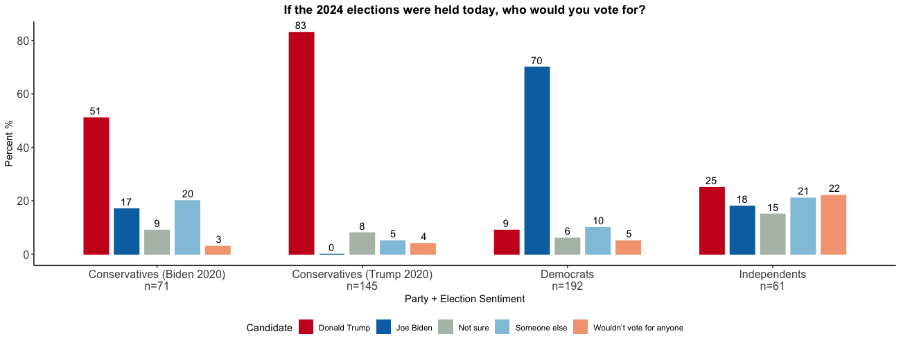
Arizona Polling

Slide 26
Virginia Polling
Total | Unweighted n | 500
 | Weighted n | 500
1 Republican |  | 148
 |  | 30%
2 Democrat |  | 164
 |  | 33%
3 Independent |  | 160
 |  | 32%
4 Something else |  | 29
 |  | 6%

Slide 27
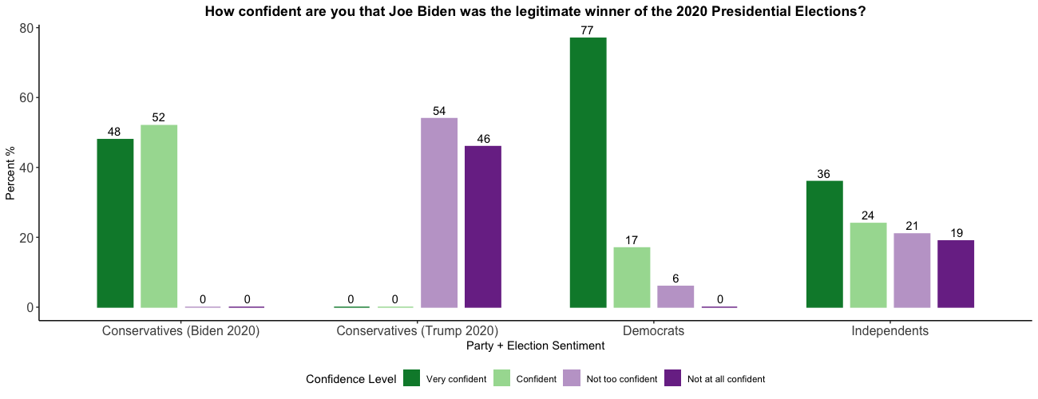
Virginia Polling

Slide 28
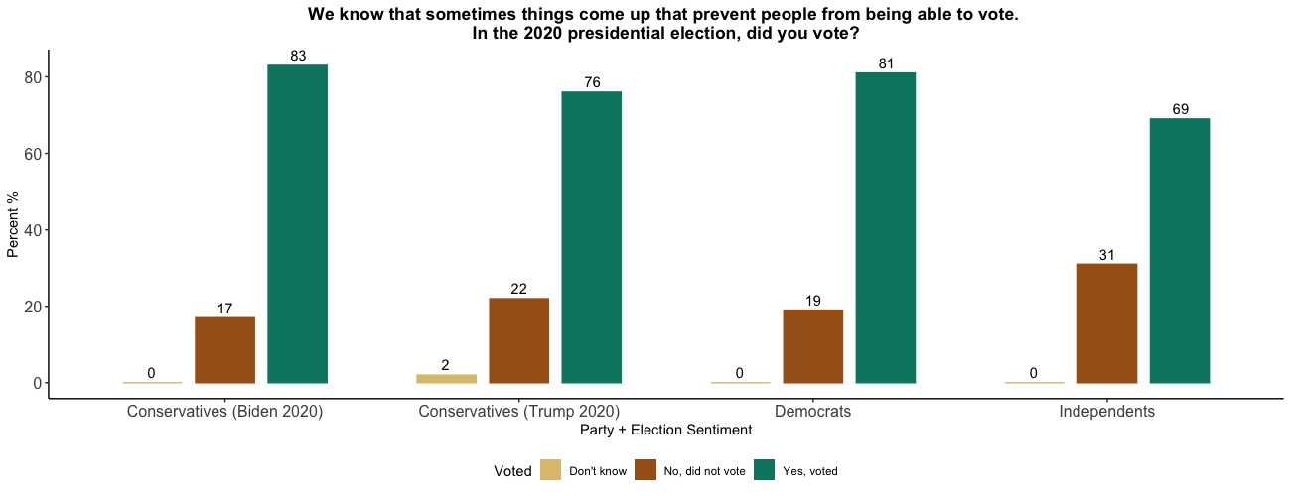
Virginia Polling

Slide 29
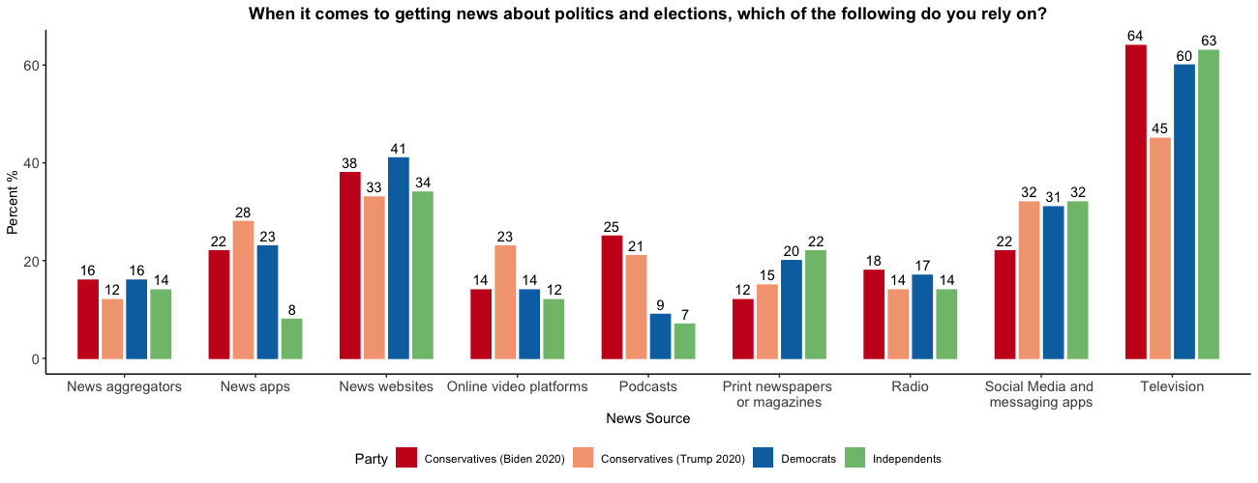
Virginia Polling

Slide 30
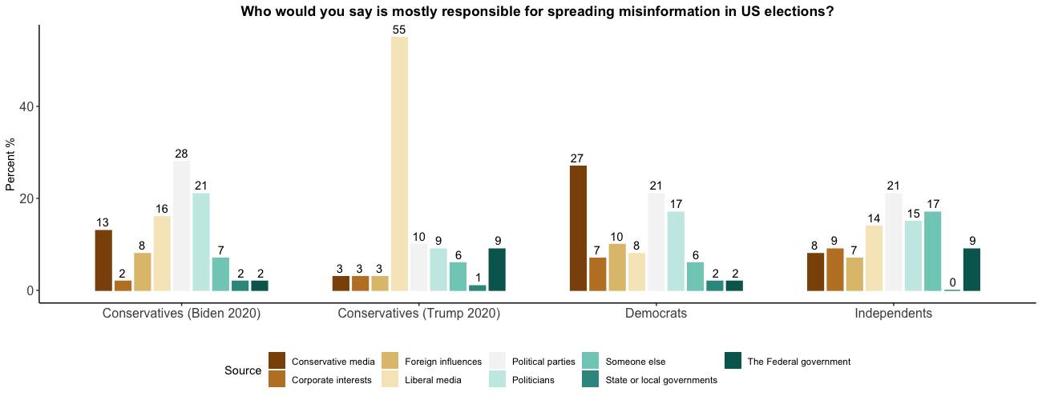
Virginia Polling

Slide 31
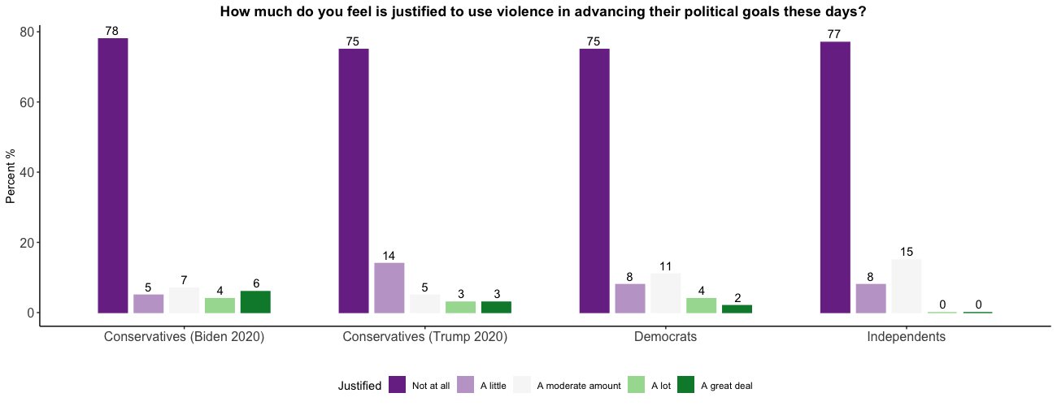
Virginia Polling

Slide 32
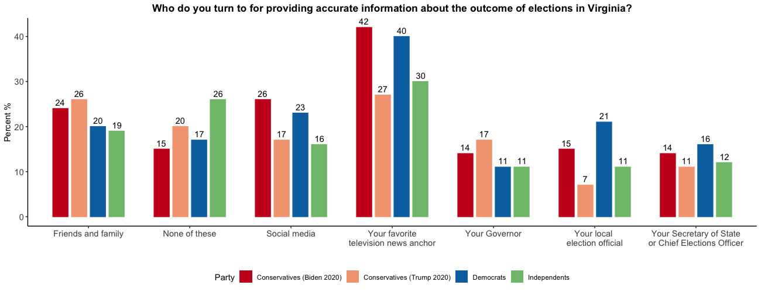
Virginia Polling

Slide 33
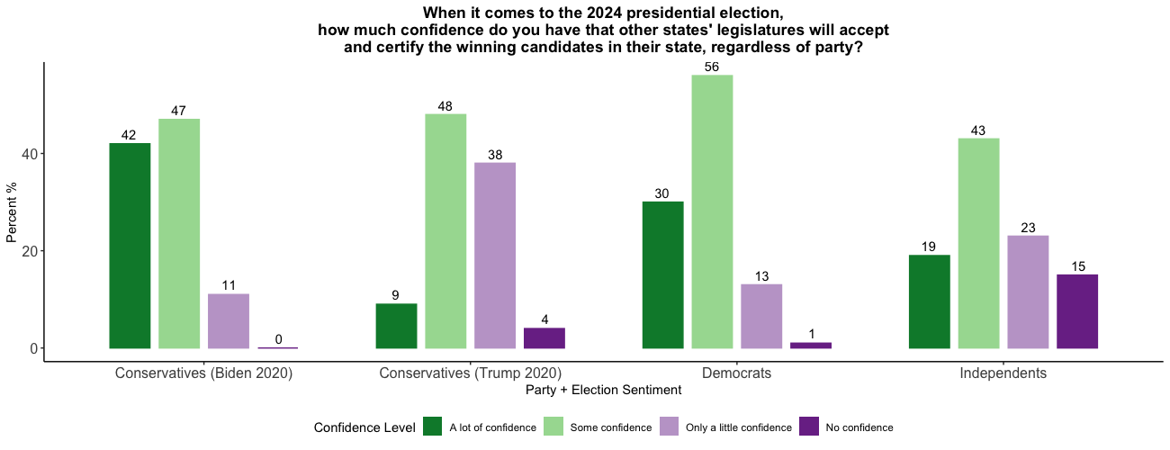
Virginia Polling

Slide 34
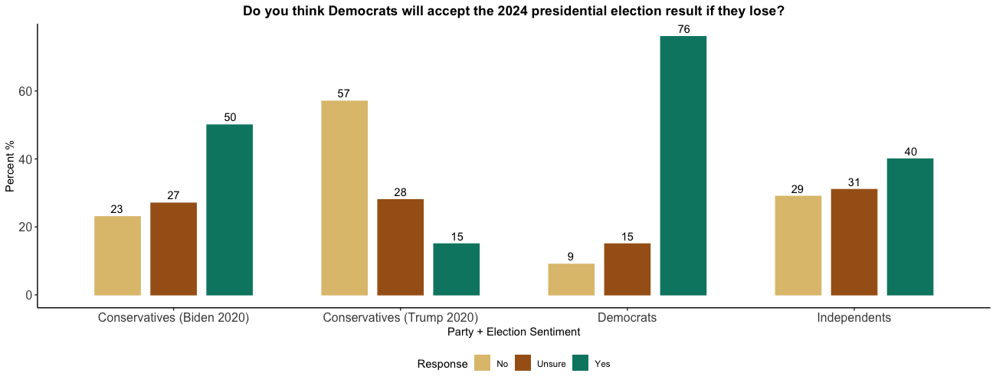
Virginia Polling

Slide 35
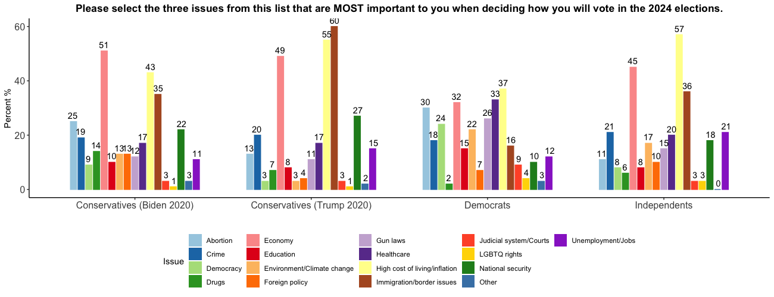
Virginia Polling

Slide 36
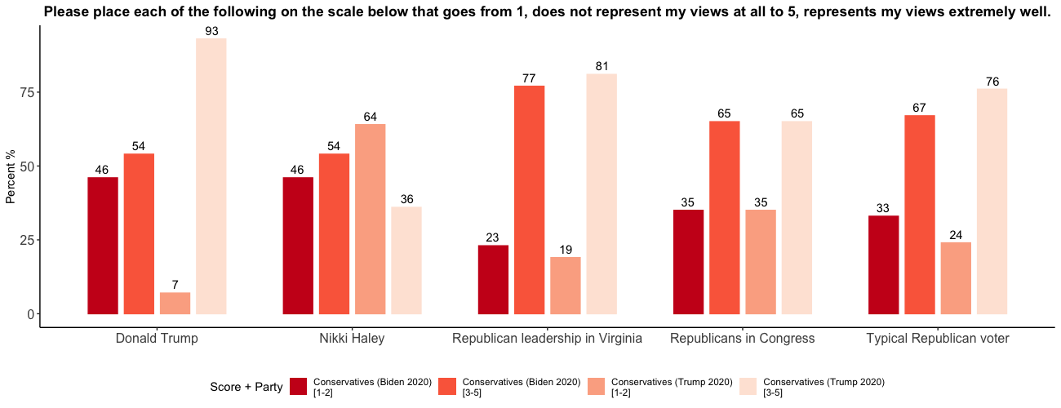
Virginia Polling

Slide 37
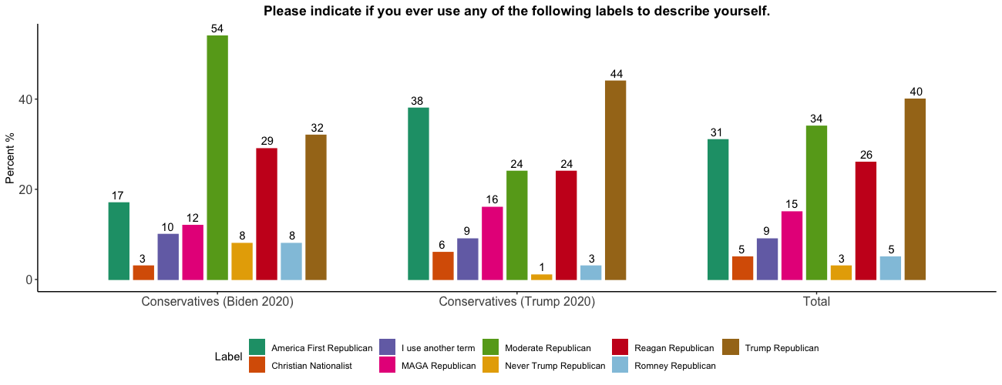
Virginia Polling

Slide 38
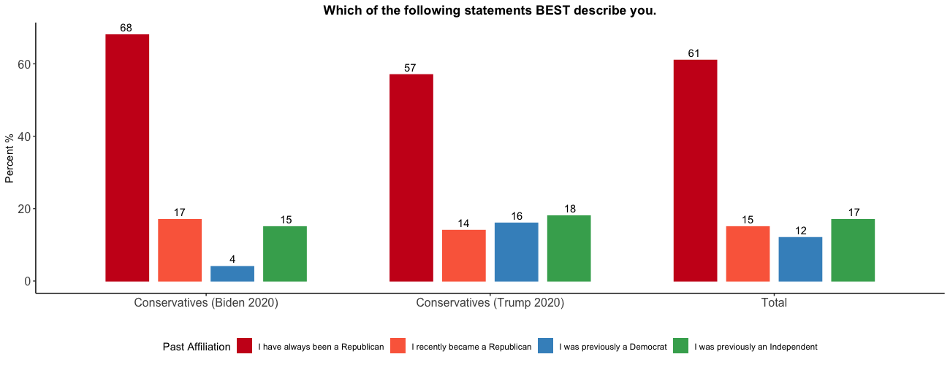
Virginia Polling

Slide 39
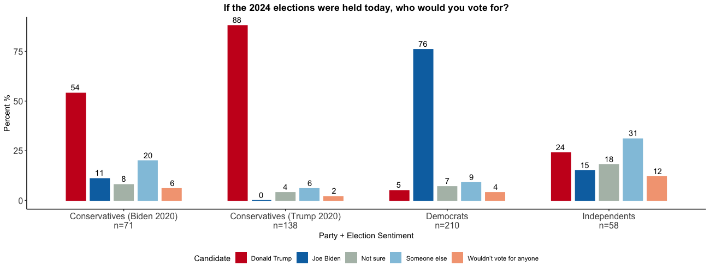
Virginia Polling

Slide 40
Georgia Polling
Total | Unweighted n | 502
 | Weighted n | 502
1 Republican |  | 170
 |  | 34%
2 Democrat |  | 159
 |  | 32%
3 Independent |  | 144
 |  | 29%
4 Something else |  | 28
 |  | 6%

Slide 41
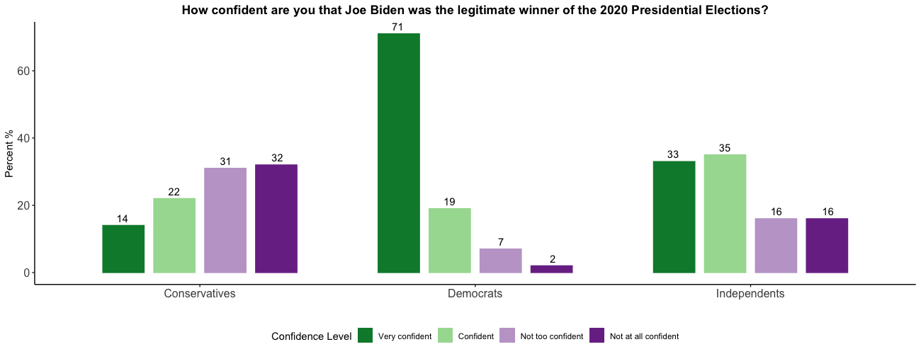
Georgia Polling

Slide 42
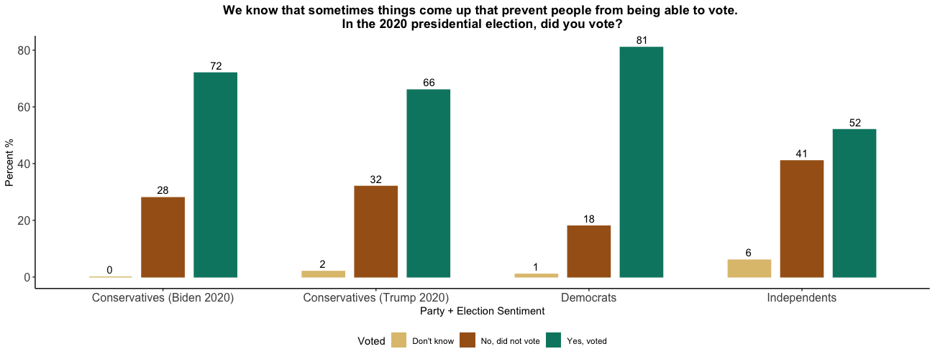
Georgia Polling

Slide 43
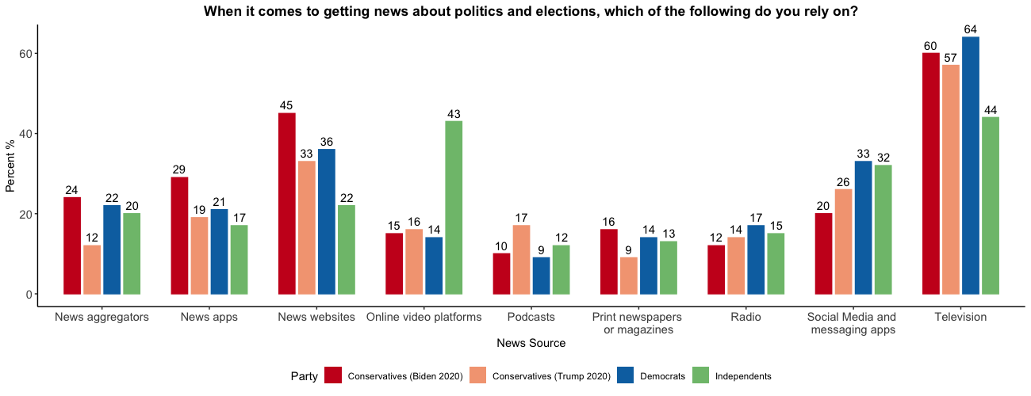
Georgia Polling

Slide 44
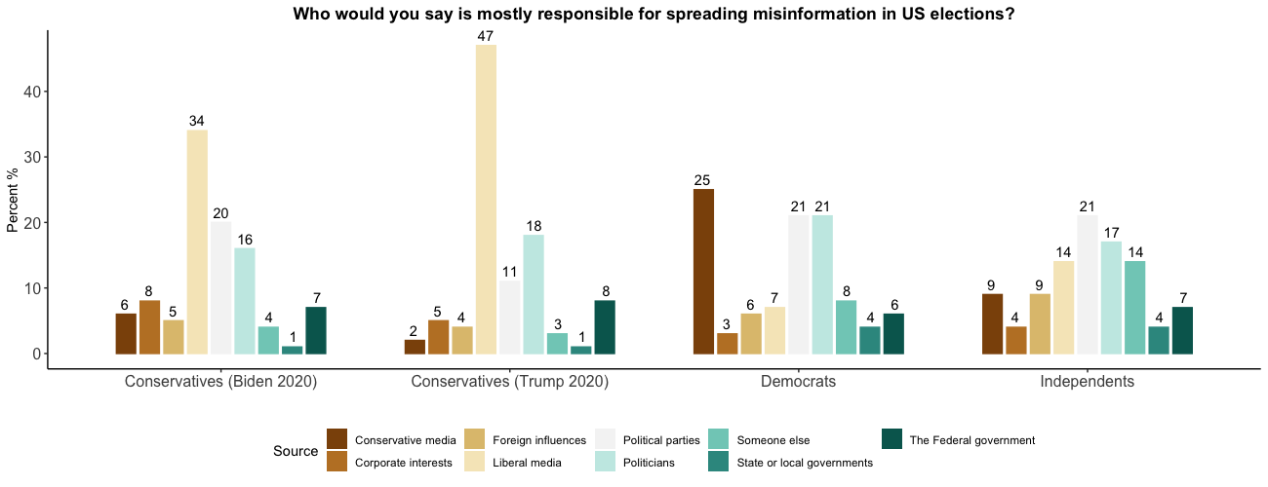
Georgia Polling

Slide 45
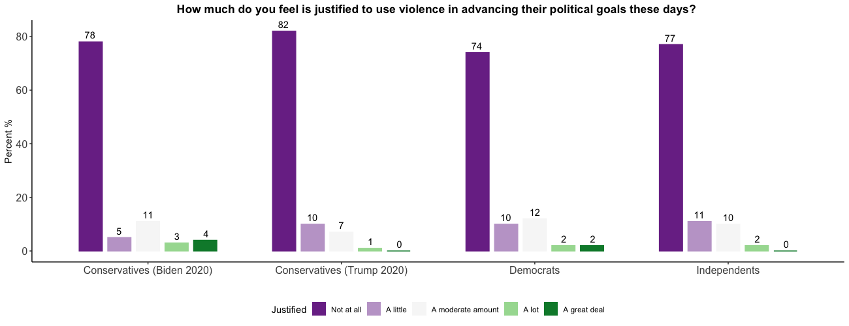
Georgia Polling

Slide 46
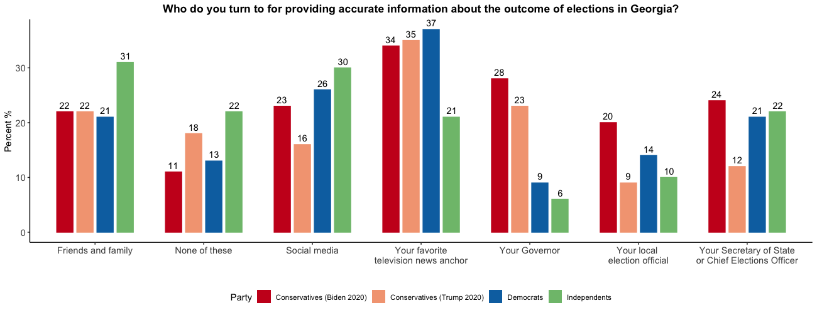
Georgia Polling

Slide 47
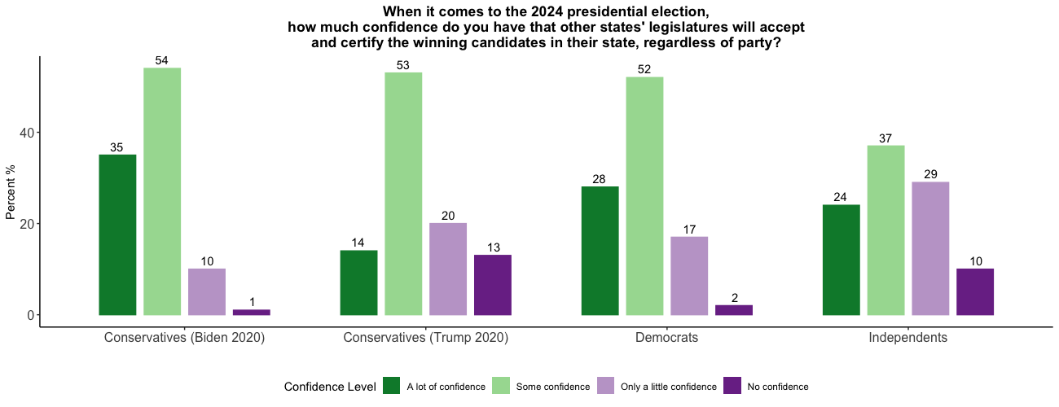
Georgia Polling

Slide 48
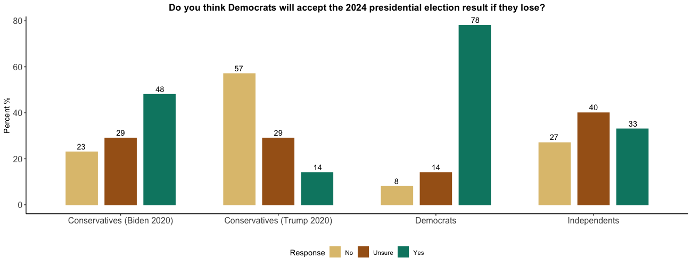
Georgia Polling

Slide 49
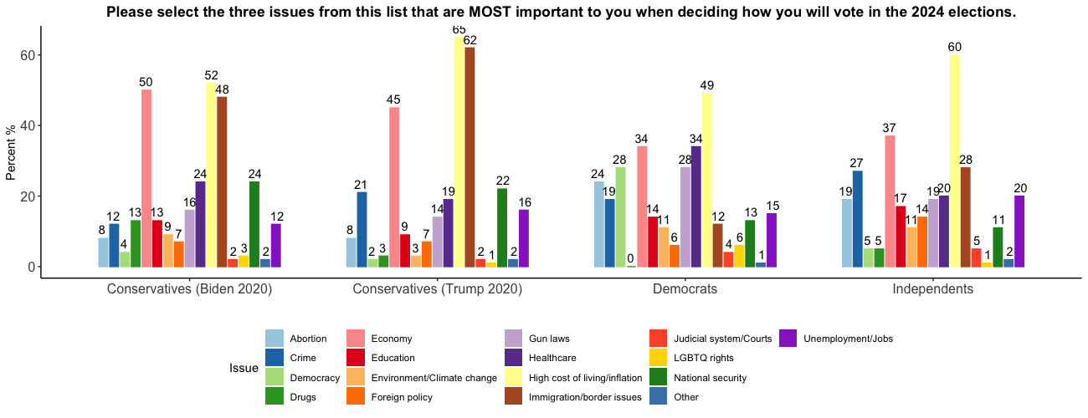
Georgia Polling

Slide 50
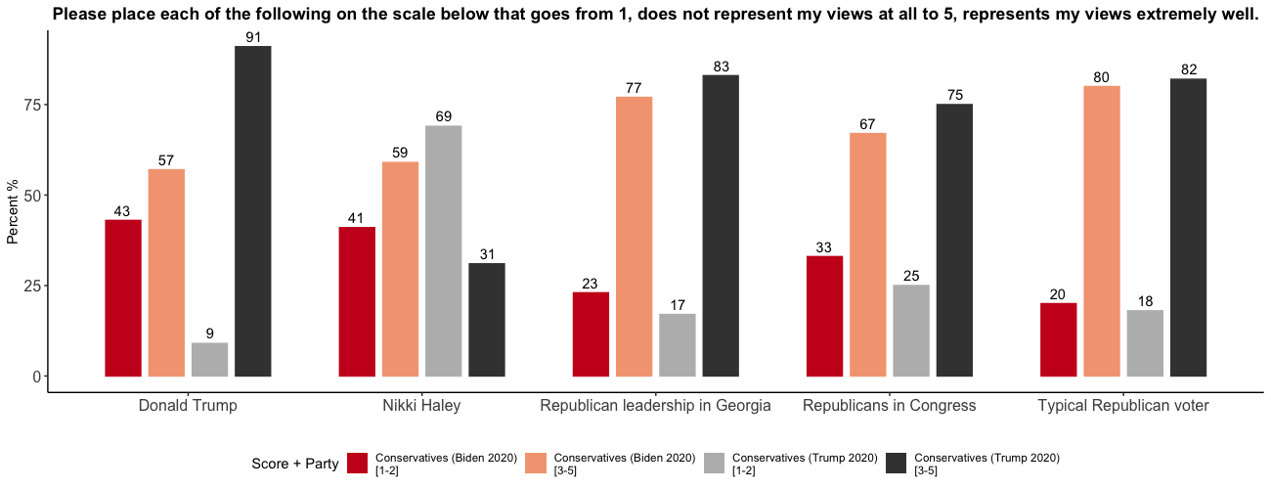
Georgia Polling

Slide 51
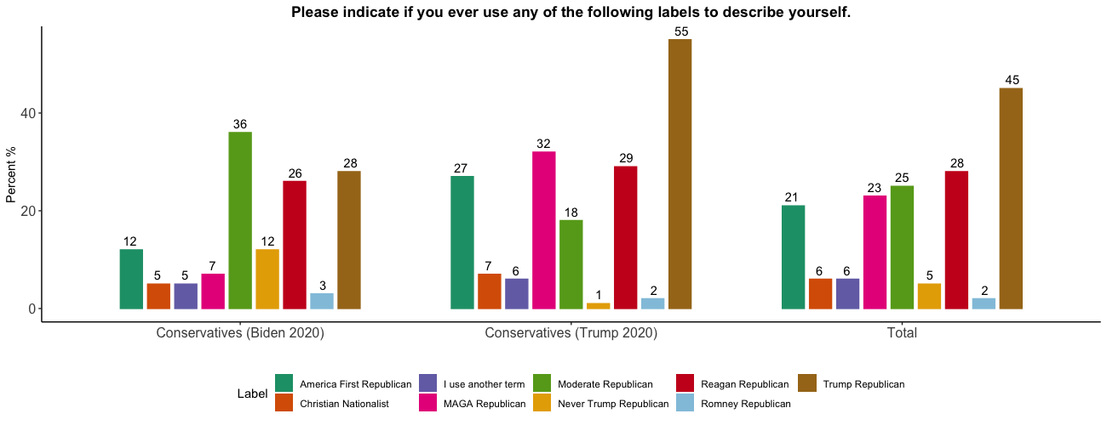
Georgia Polling

Slide 52
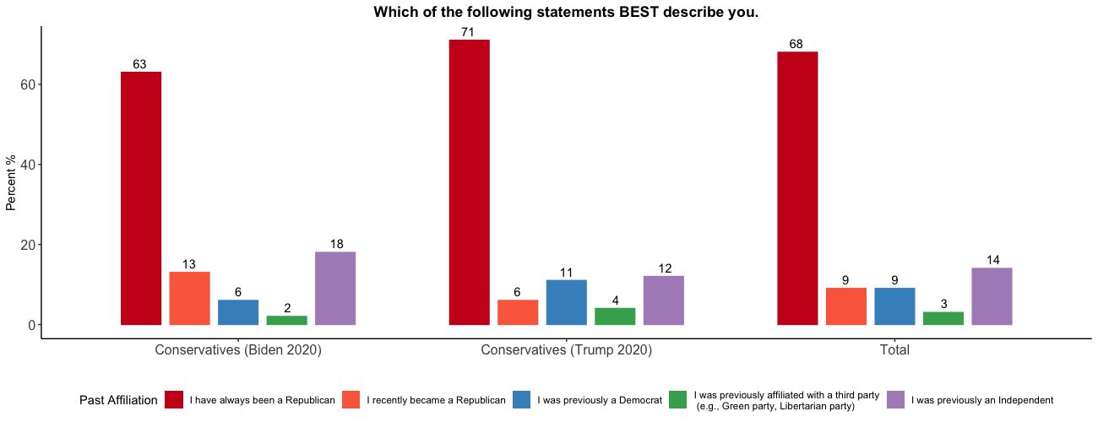
Georgia Polling

Slide 53
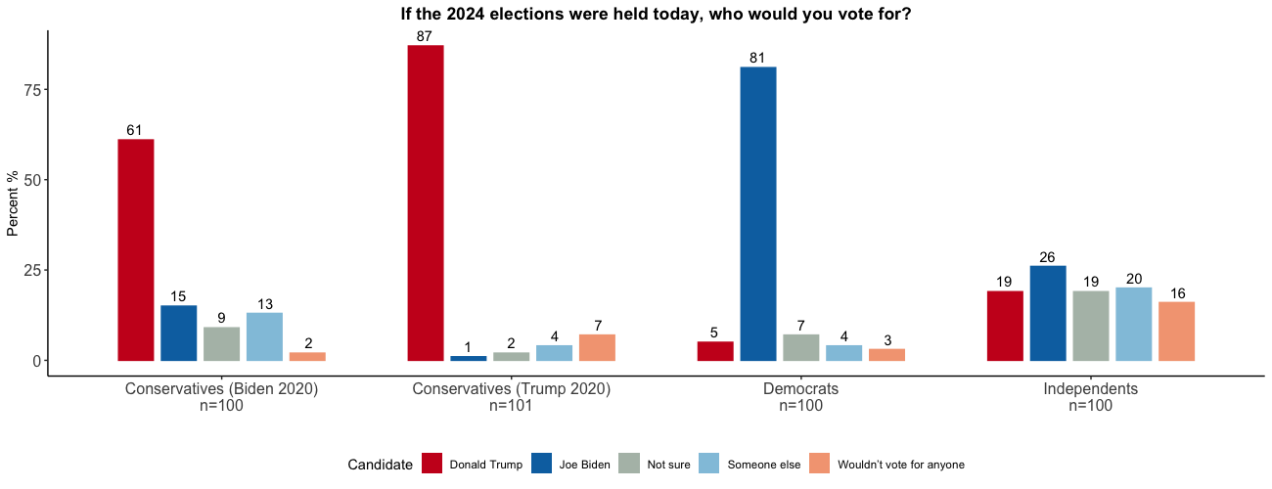
Georgia Polling

Slide 54
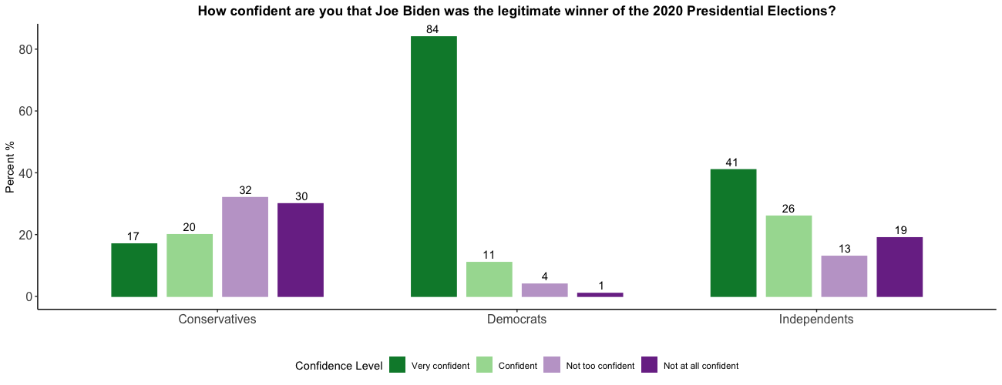
Utah Polling

Slide 55
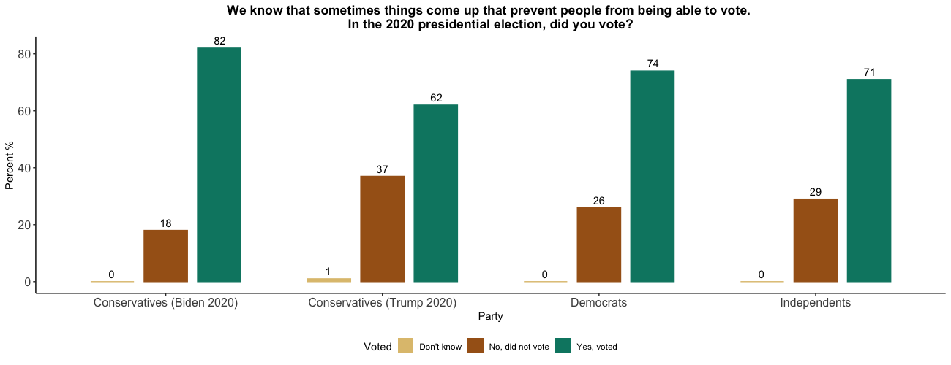
Utah Polling

Slide 56
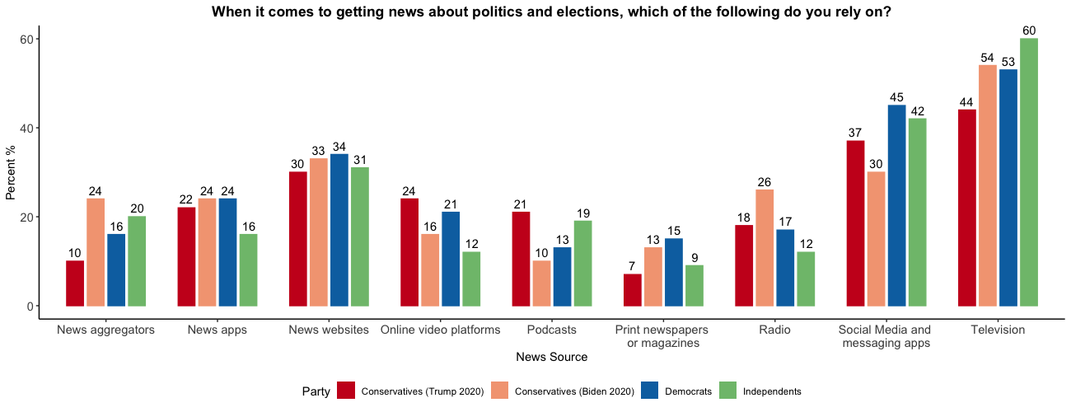
Utah Polling

Slide 57
Utah Polling

Slide 58
Utah Polling

Slide 59
Utah Polling

Slide 60
Utah Polling

Slide 61
Utah Polling

Slide 62
Utah Polling

Slide 63
Utah Polling

Slide 64
Utah Polling

Slide 65
Utah Polling

Slide 66
Utah Polling

Slide 67
Kansas Polling
Total | Unweighted n | 501
 | Weighted n | 501
1 Republican |  | 179
 |  | 36%
2 Democrat |  | 121
 |  | 24%
3 Independent |  | 158
 |  | 32%
4 Something else |  | 42
 |  | 8%

Slide 68
Kansas Polling

Slide 69
Kansas Polling

Slide 70
Kansas Polling

Slide 71
Kansas Polling

Slide 72
Kansas Polling

Slide 73
Kansas Polling

Slide 74
Kansas Polling

Slide 75
Kansas Polling

Slide 76
Kansas Polling

Slide 77
Kansas Polling

Slide 78
Kansas Polling

Slide 79
Kansas Polling

Slide 80
Kansas Polling

